Slide 1

Grow Mate
Projeto em Informática – Sensing My Home
Licenciatura em Engenharia Informática
Grupo 5

Slide 2

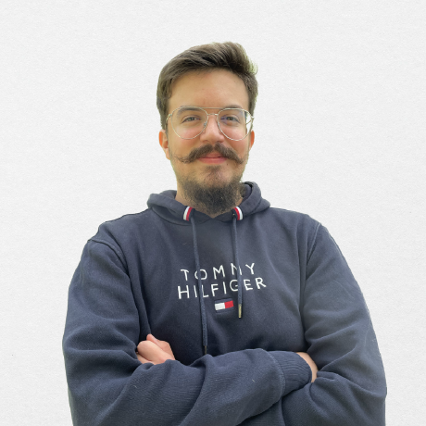
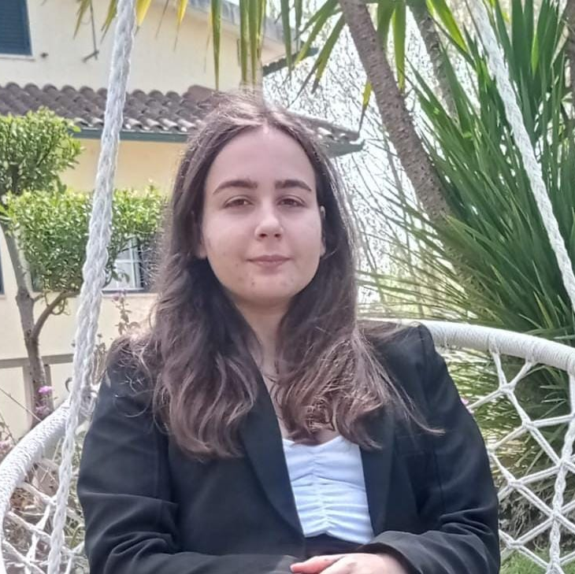

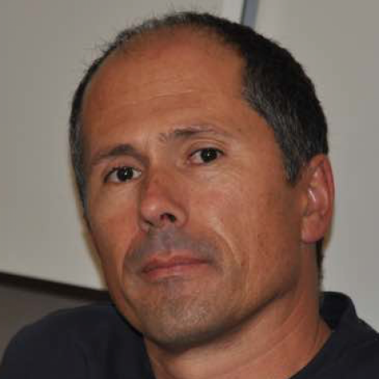
The Team
Artur Correia
André Butuc
Bruna Simões
Daniel Carvalho
José Luís Oliveira
(Advisor)
1

Slide 3
Project Context

Slide 4
Context
40%
Development of a mobile app to manage house plants.
Facilitate the acclimatization process of plant species.
Provide daily reminders and suggestions to assure that the plants are receiving its proper needed care.
Suggest plant species that follow similar growth patterns and behavior.
3

Slide 5
Functional Requirements
Business Rules
Full catalogue of plants available in the database
All Users
Information about the species, ideal conditions for growth
Comments made by users with tips about their experience with the plants
Reputation system to influence which users' tips appear, based on their experience
House Plants Inventory and Management
Identify and monitor each individual plant
Journalling system
Suggestion of optimal conditions for each plant
All
Registered Users
Optimal temperature, humidity, luminosity and water frequency
Ideal soil mix, pot size and recommendations of additional nutrients and fertilizers
Expected color, size and condition
Tips on detection of pests and disease symptoms
Scheduling of tasks for plant maintenance, with notifications and reminders
4

Slide 6
Functional Requirements
Business Rules
Suggestion of new plants to grow
Takes into account the similarity with plants in the inventory of the user, as well as difficulty
Takes into account the climate
All
Registered Users
Acclimatization guide for newly bought plants, when necessary
Potential integration with weather API
Integration with measurements provided by sensors
Premium Users
Only
Sensors that measure the individual characteristics of a plant – soil moisture
Sensors that measures shared characteristics of all plants in a division – air temperature and humidity
Plant condition presented in a traffic light system
Comparison between measured conditions and optimal conditions
5

Slide 7
Other Functional Requirements
Administrative Functions
Web dashboard for database administrator
Admin can do CRUD operations over the DB
Admin can see relevant statistics related to the users
Authentication and Authorization Levels
Separation of functionalities according to the type of account
Historical Data
History of a user’s actions and history of sensors measurement for each plant
6

Slide 8

Actors
User with premium account
System Administrator
User without account
User with account
7

Slide 9

Expected results
Mobile application
Sensors’ integration and monitoring
Database of several plant species conditions and characteristics, accessed via an API
8

Slide 10
System Architecture

Slide 11
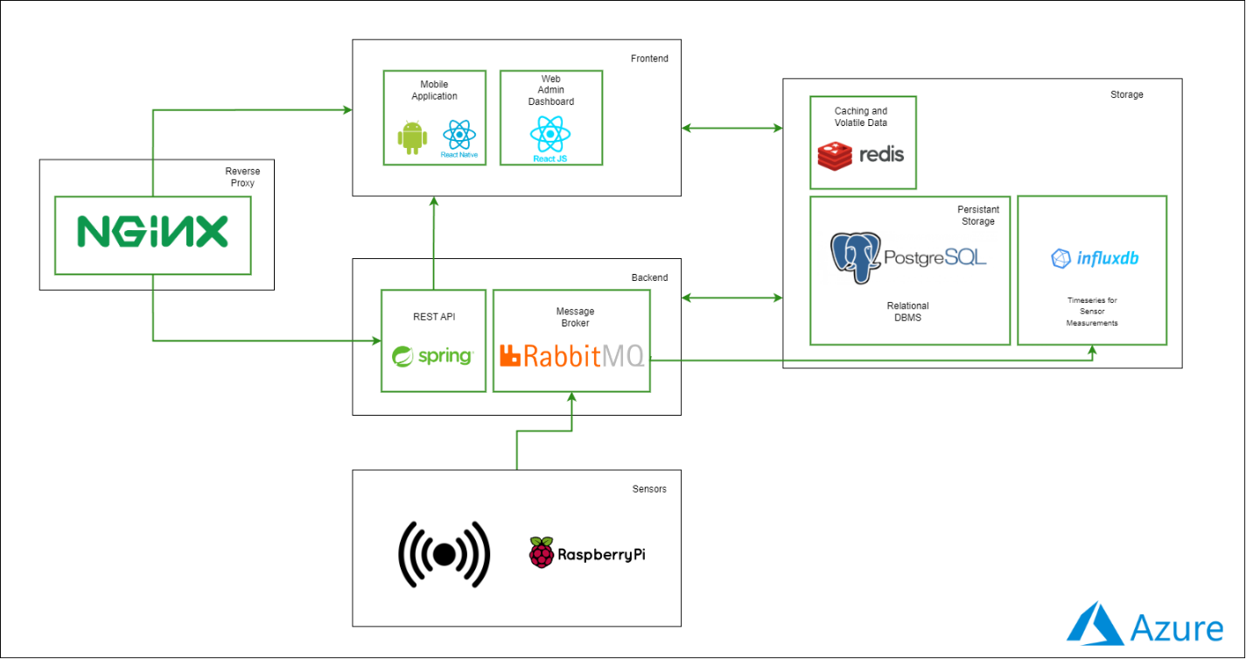
System Architecture & Deployment
10

Slide 12
Third Milestone

Slide 13
The Story So Far…
Sensors Architecture
Implementation of Core User Stories
Finalize the planning of the sensor’s architecture
Installation of mqtt broker
Data flow between sensors and backend using RabbitMQ
Plant Inventory Management
Management of Divisions and Sensors
Management of Tasks
Presentation of the catalogue of species
Frontend Screens
Full database modelling
Backend API logic to support the implemented screens
12

Slide 14
…Not Without Problems
Trouble integrating the time-series InfluxDB database with the Spring Boot framework
We couldn’t test the full sequence of sending measures from the sensors to the Frontend
Plan A: Continue trying with InfluxDB
Plan B: Checking out other timeseries databases Plan C: Just using PostgresSQL
13

Slide 15
Original Schedule
Milestone 2
Presentation of the lifecycle architecture
Milestone 3
Protoype; Mid-Term Presentation
14/03
Milestone 3.1
11/04
24/03
MARCH
APRIL
Defining core user stories
Non-Functional UI prototypes
Database
Modellling
UI Development based on the main core user stories
Sensor data generation and integration basic pipeline
Core user stories implemented for the demonstration of the full-stack architecture
14

Slide 16
Demo

Slide 17
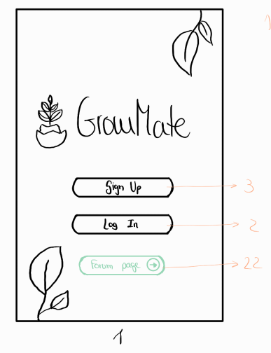
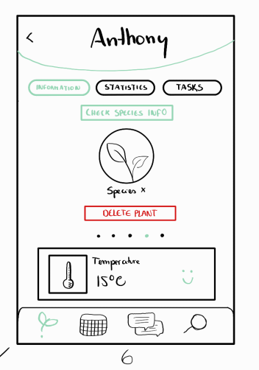
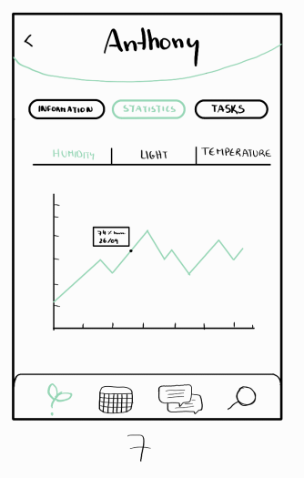

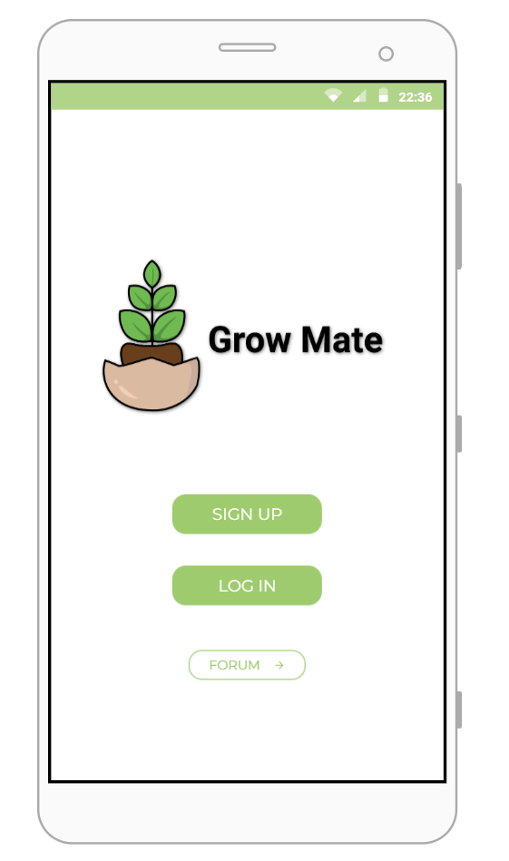
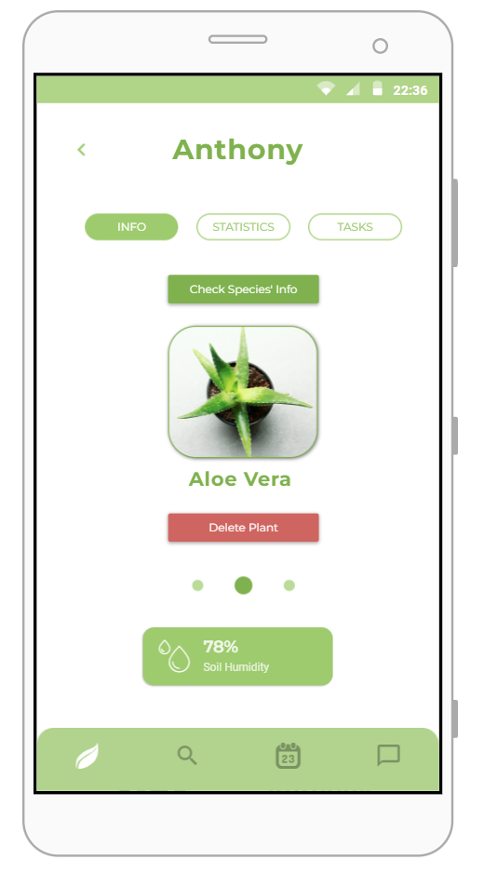
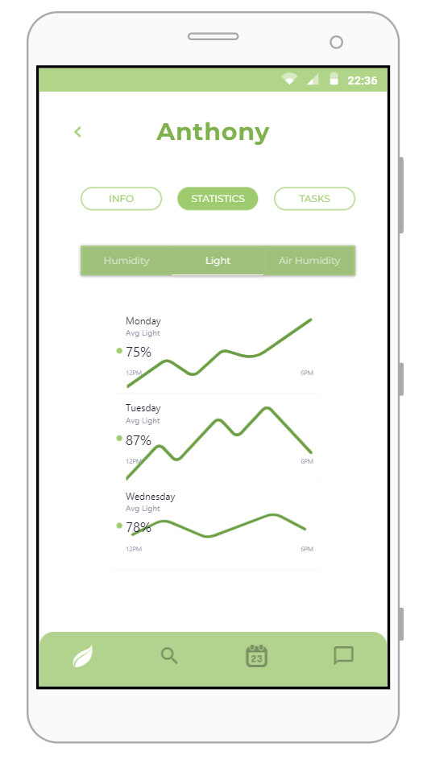
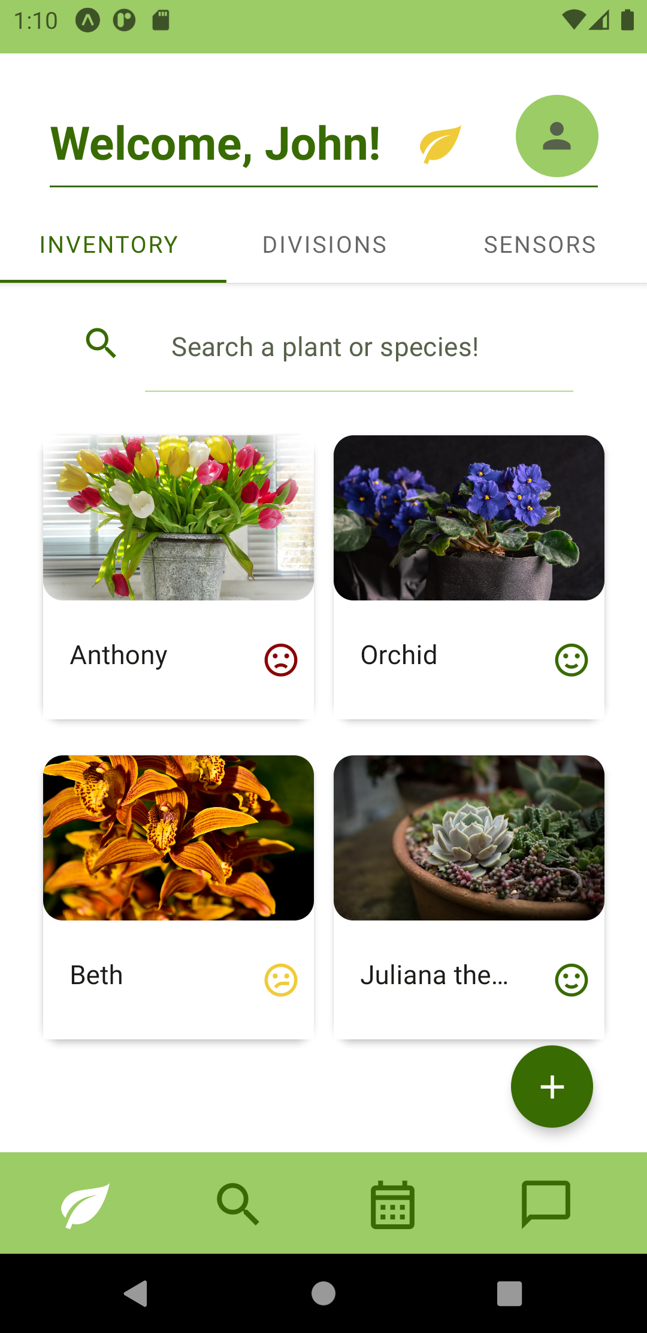
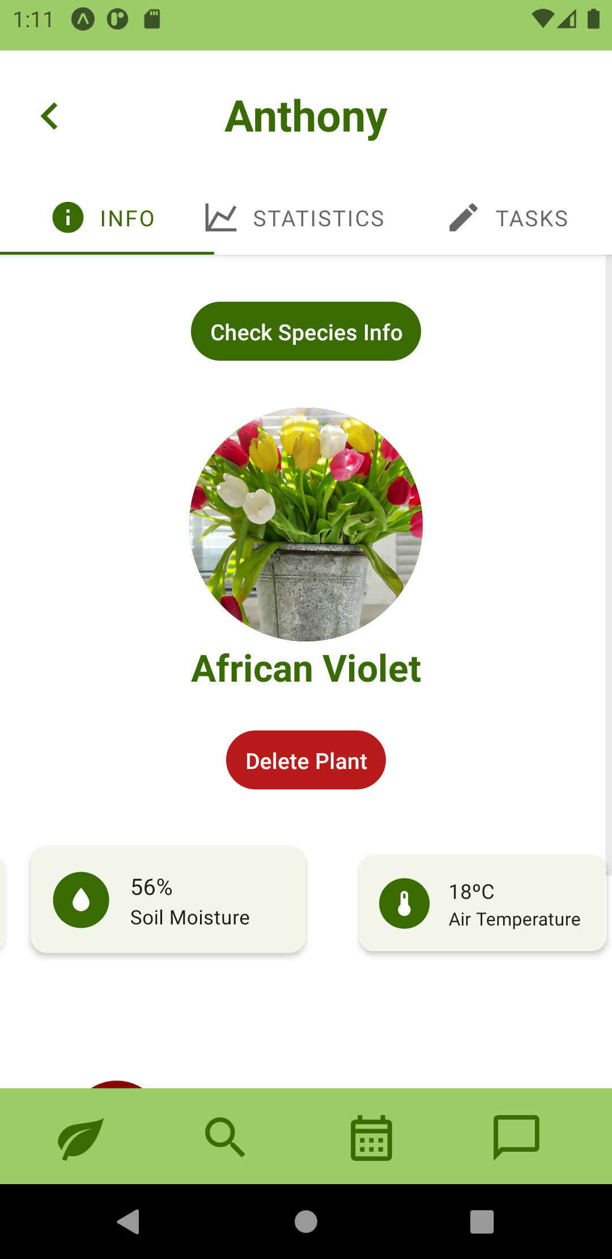
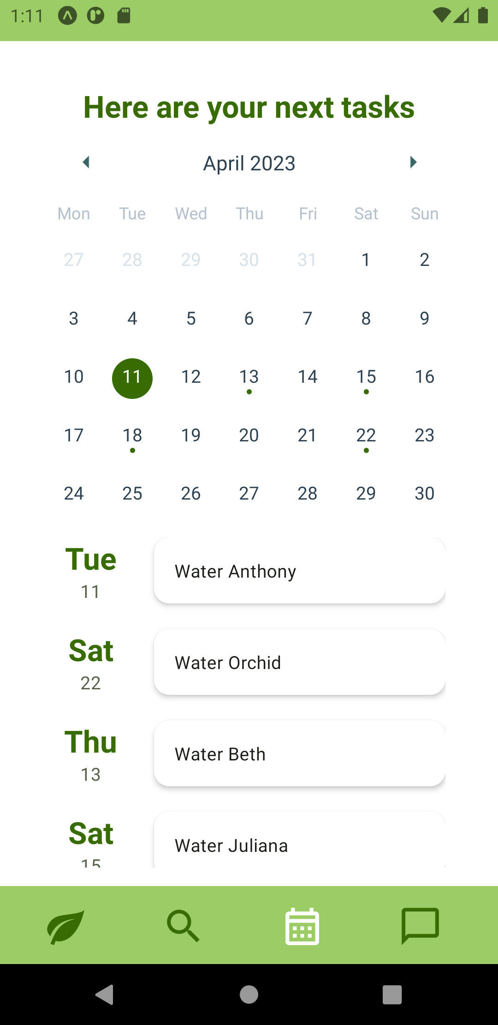
Prototipo_.pdf
Grow Mate.pdf
16

Slide 18
Upcoming Work

Slide 19
The Next Steps
Implemented Use Cases
Final Use Cases
Remaining Architecture
Stabilization of the developed Frontend and Backend
Redesign of the Tasks section for individual Plants
Business logic algorithms
(ie. automatic task scheduling, suggestion of new plants, difficulty determination, etc)
Stabilization of Sensor Integration
Forum and tips section
Admin dashboard
Cache Implementation
Nginx Server
Deployment Structure
MAY (Hopefully)
18

Slide 20
Grow Mate

